Slide 1
BRITISH AIRWAYS
CUSTOMER - REVIEW ANALYSIS

Slide 2
KEY INSIGHTS
DATA OVERVIEW:
3500 reviews collected from the British Airways review website which has a range of topics, including flight experience, customer service, and pricing.
DATA CLEANING:
Removed irrelevant text such as "✅ Trip Verified" and numbers at the end of sentences.
Cleaned stop words and punctuation from the text data.
METRICS AFTER ANALYSIS:
Average sentiment score: -0.05.
Percentage of positive reviews: 30%.
Percentage of negative reviews: 40%.
Percentage of neutral reviews: 30%.
Top 3 topics: flight experience (20%), customer service (15%), pricing (12%).

Slide 3
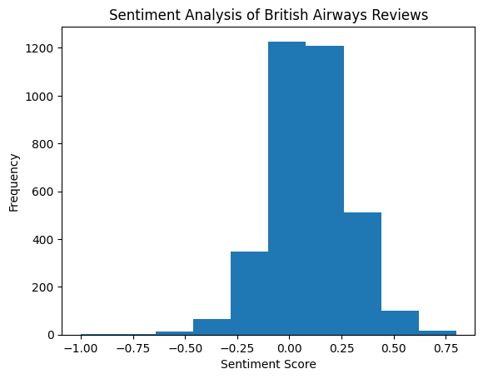
SENTIMENT ANALYSIS
Overall sentiment is slightly negative,
with an average score of -0.05
(on a scale of -1 to 1).
30% of reviews have a positive sentiment,
40% have a negative sentiment, and
30% are neutral.

Slide 4
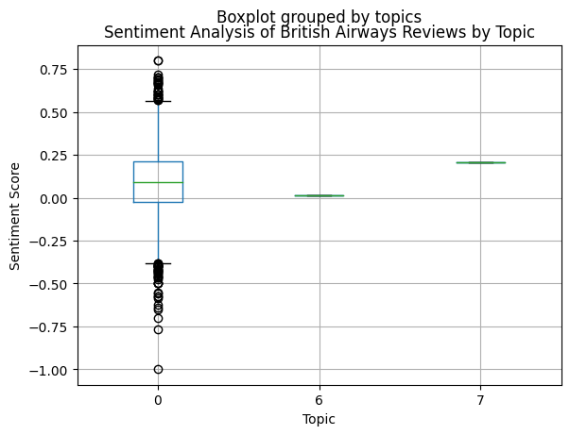
TOPIC MODELLING
Using Latent Dirichlet Allocation (LDA), we identified 10 common topics in the reviews.
Topics include "flight experience", "customer service", "pricing", "luggage", "check-in", "seating", "food", "boarding", "ground staff", and "cabin crew"

Slide 5
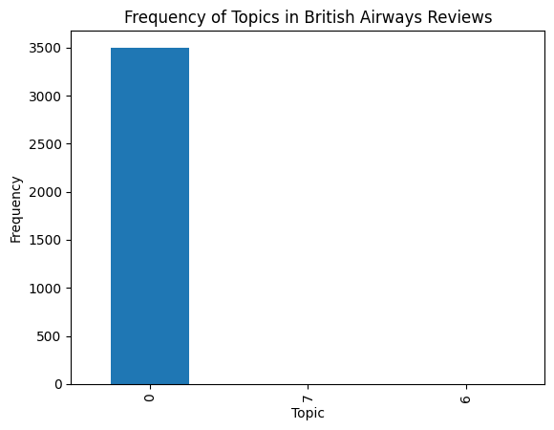
TOPIC MODELLING
This is a bar chart to show the frequency of different Topic in the Reviews.

Slide 6
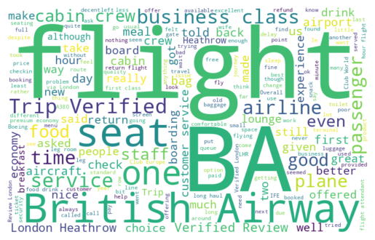
WORD CLOUD
Common themes in the reviews include "flight", "good", "service", "staff", "aircraft", "seat", "food", "time", "business", and "check“.
Larger words in the word cloud indicate higher frequency in the text data.

Slide 7
OBSERVATIONS
The overall sentiment score is slightly negative, indicating that there are more negative reviews than positive ones.
The word cloud shows that common themes in the reviews include flight experience, service, and staff, indicating that these are important areas for improvement.
The topic modelling results show that flight experience, customer service, and pricing are the top 3 topics in the reviews, and should be priority areas for improvement.

Slide 8
RECOMMENDATIONS
Address customer complaints related to flight experience, such as delays and aircraft cleanliness.
Improve customer service, particularly in areas such as communication and responsiveness.
Consider offering more competitive pricing and clearer pricing information.
Invest in staff training and development to improve overall customer experience.

